Slide 1
Element Fusion
By Pixel Code
Jamie Collinge – Artist
Michael Sweeney - Programmer

Slide 2
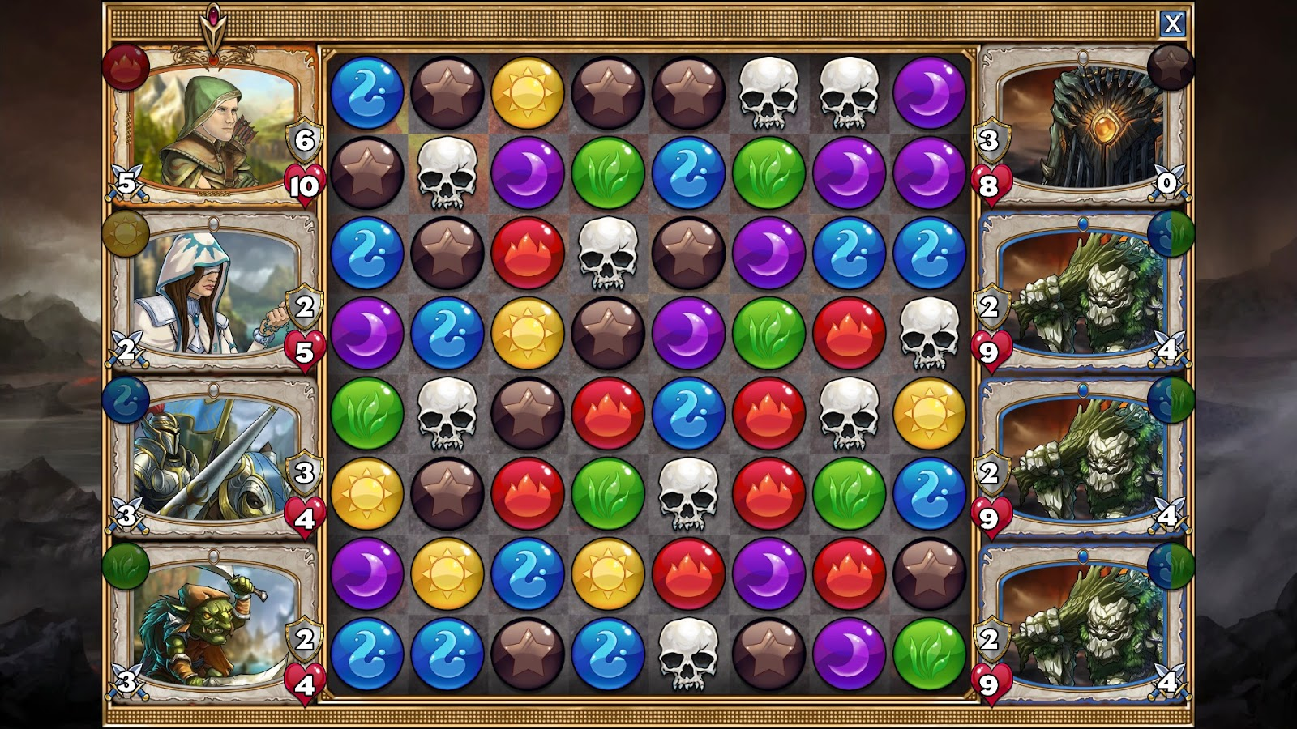
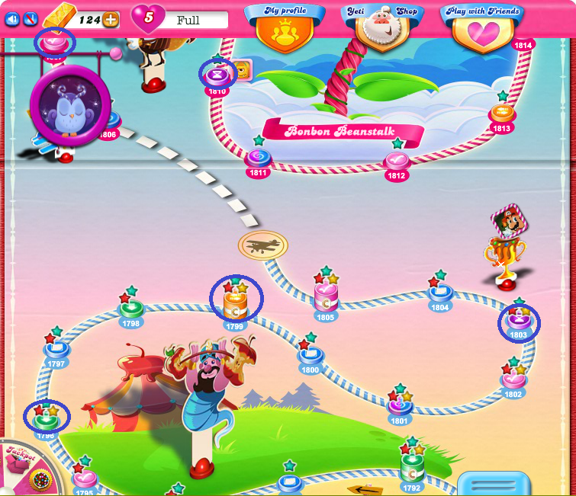
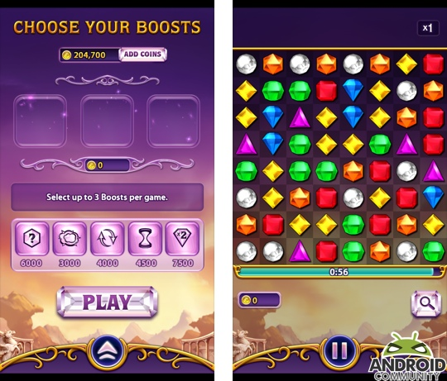
Research
Gems of War
Bejewelled Blitz
Candy Crush Saga
Notes:
https://www.choicestgames.com/2014/11/gems-of-war-review.html
https://androidcommunity.com/bejeweled-blitz-launches-for-android-20130503/
https://care.king.com/en/candy-crush-saga/all-hexagon-levels-on-candy-crush-saga-are-removedhttps://care.king.com/data/king_qna_en/media/forum/image/05/74/63/69712/4616/19daab74552b8e0f/wherearehexagonlevel..png

Slide 3
Analytics
Mixed Story Progression
Players utilising the shop
Scramble most popular
Store Usage

Slide 4
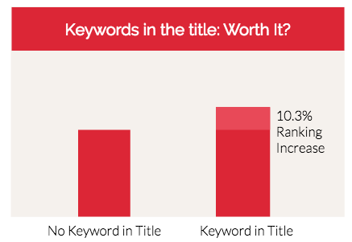
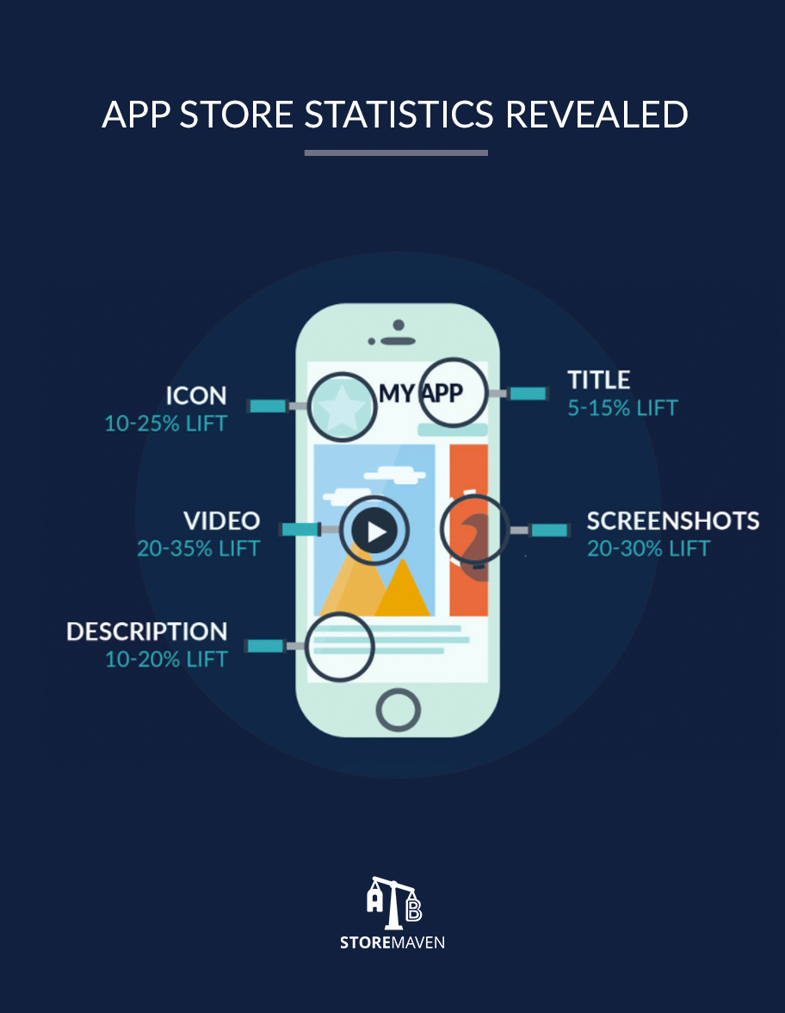
Marketing
Android Store
iPhone Store
Announcement on social media
App Store Optimisation
Notes:
https://moz.com/blog/app-store-optimization-checklist
https://neilpatel.com/blog/everything-need-know-app-store-optimization/

Slide 5
Social Media

Slide 6
Art Development
Show Art Progression

Slide 7
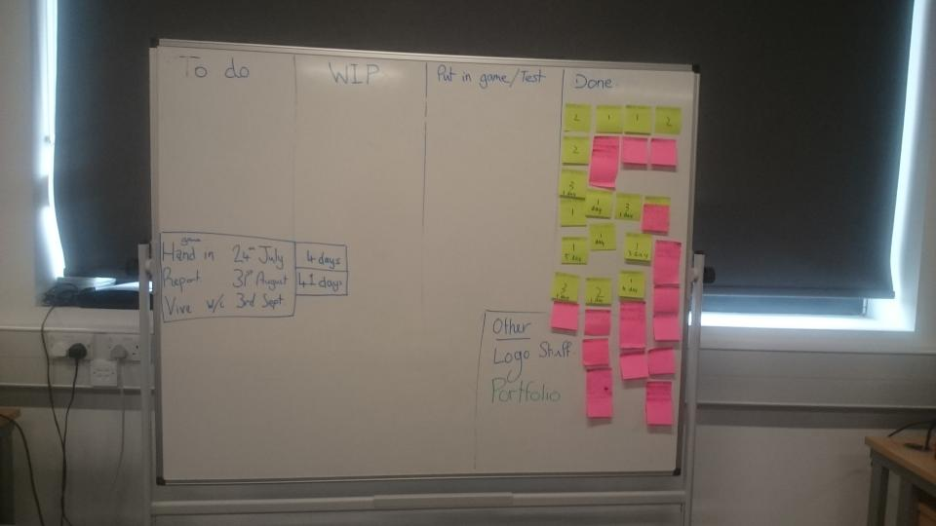
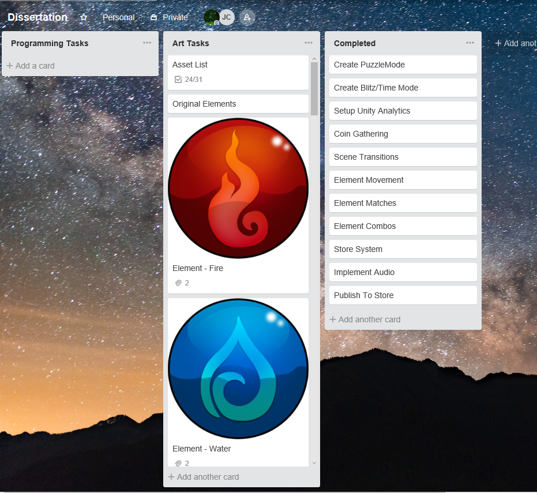
Project Management
KanBan
Trello

Slide 8

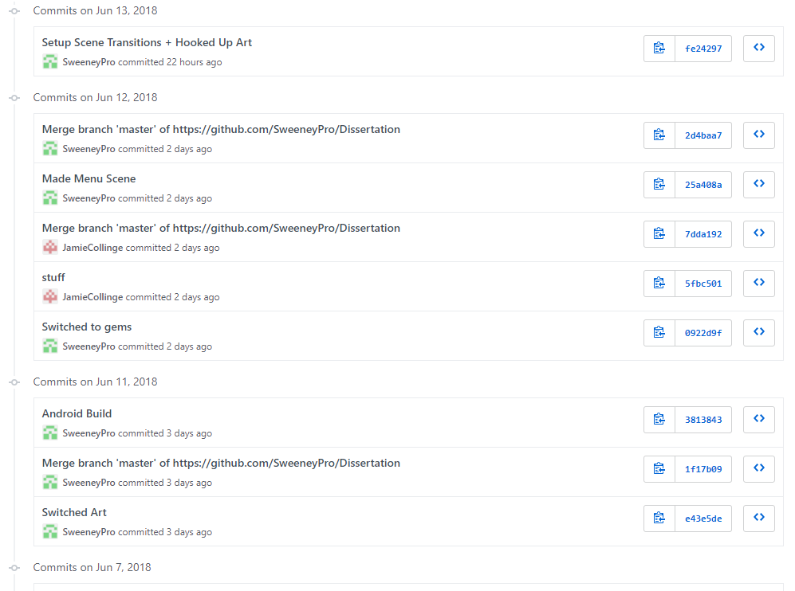

Source Control
Git
GitHub Repo
GitHub Client

Slide 9
Any Questions?

Slide 11
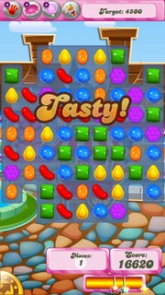
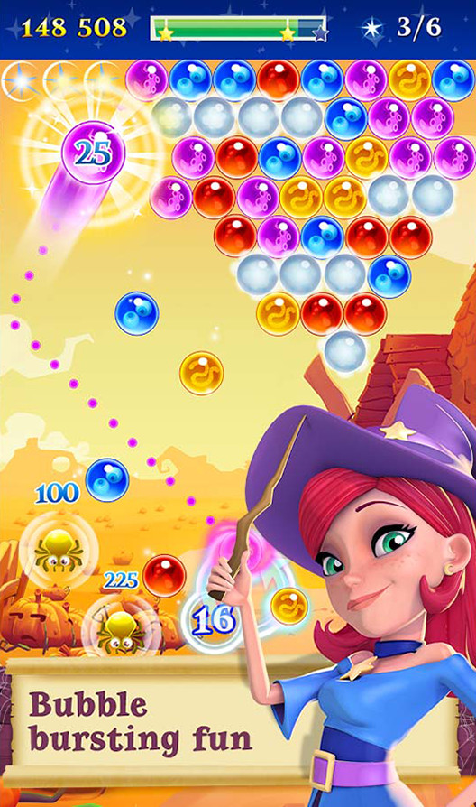
What is a Match 3 Game
Aim of the game is to combine 3 matching tiles
Often has combos for matching more than 3 tiles at a time
Progression in the form of level progression and/or high score
Is a genre dominated by King with games from the Saga series such as Candy Crush Saga
Has multiple styles of matching tiles systems such as Bubble Witch’s style

Slide 12
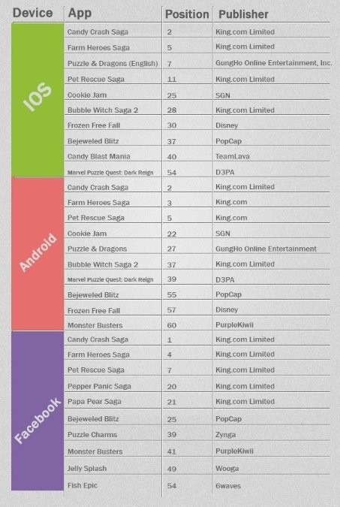
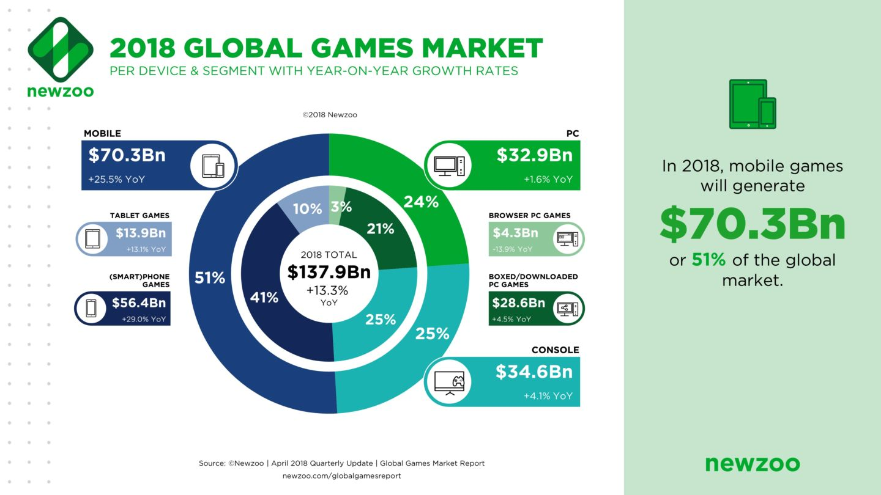
Research
Market dominated by standard Match-3
In the U.S., the average consumer is now spending 33 minutes per day in mobile games, with sessions that have increased to 7 minutes, 6 seconds this year, up from 6 minutes, 22 seconds in 2016. (TechCrunch, Sarah Perez, 2017)
Mobile market dominance

Slide 13
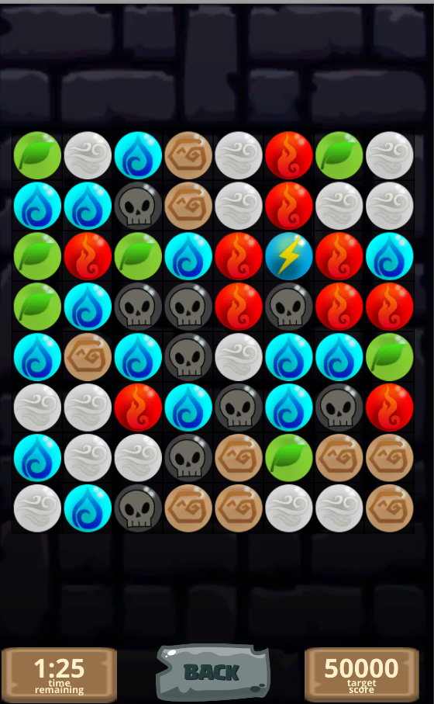
Project Proposal
Candy Crush-Style Match 3
Elements Art Theme
Android phone/tablet + (iPhone + Windows PC)
Time/Blitz Mode + (Puzzle Mode)
Power Ups Shop

Slide 14
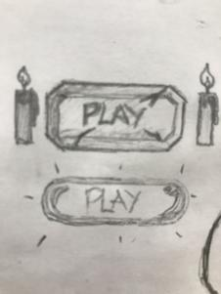
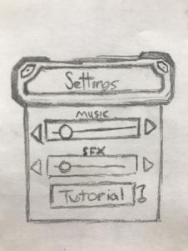
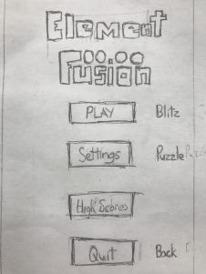
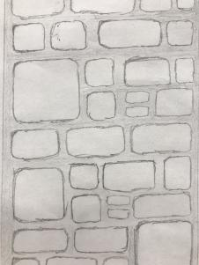
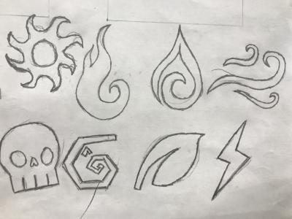
Concept Art

Slide 15
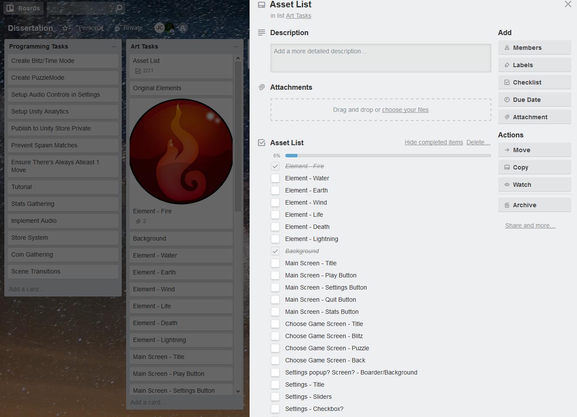
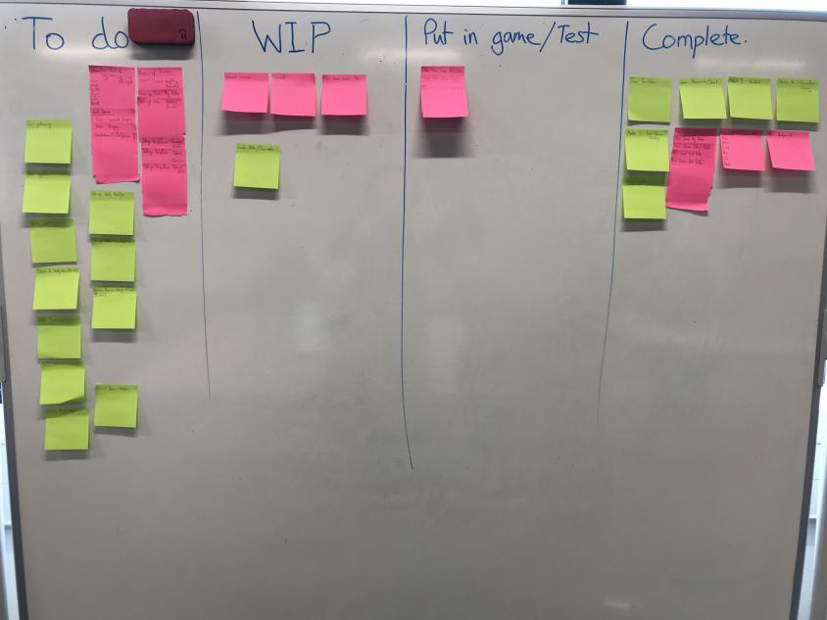
Project Plan
KanBan – Daily tasks management
Trello – Weekly Task Repository

Slide 16
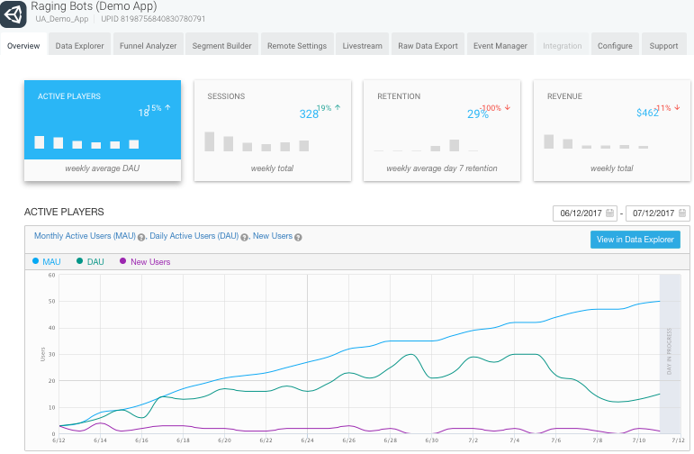
Testing
Unity Analytics
Store presence allows for wider test base
Weekly builds on multiple devices

Slide 17
Source Control
Git
GitHub Repo
GitHub Client

Slide 18

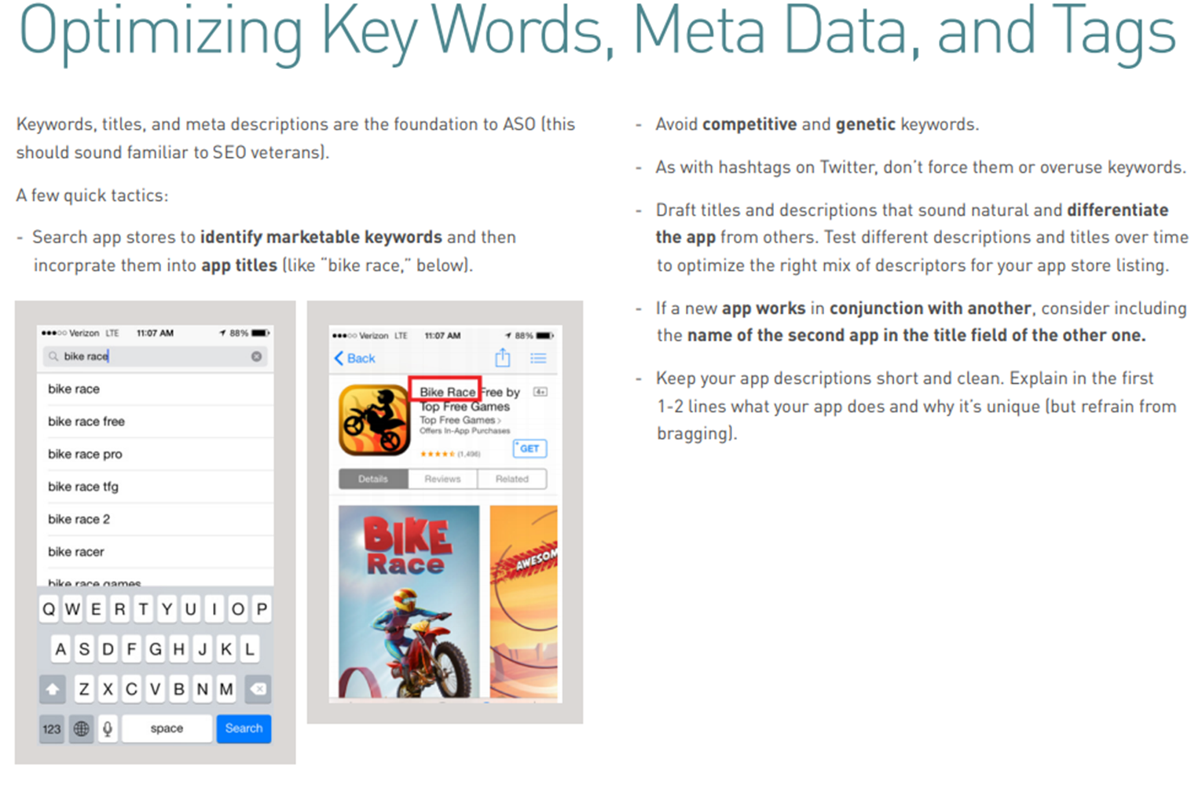
Marketing Strategy
Wide Platform range
App Store Optimising
Social media presence

